Slide 1
U.S. Copyright Law
INFO 4940/5940
Instructor: Mike Priehs
Rights: Distribution & Performance
March 17, 2025

Slide 2
Last Week – Rights: Reproduction & Modification
Reproduction
Improper Appropriation
Derivative Works

Slide 3
Rights: Distribution & Performance
Distribution

Slide 4
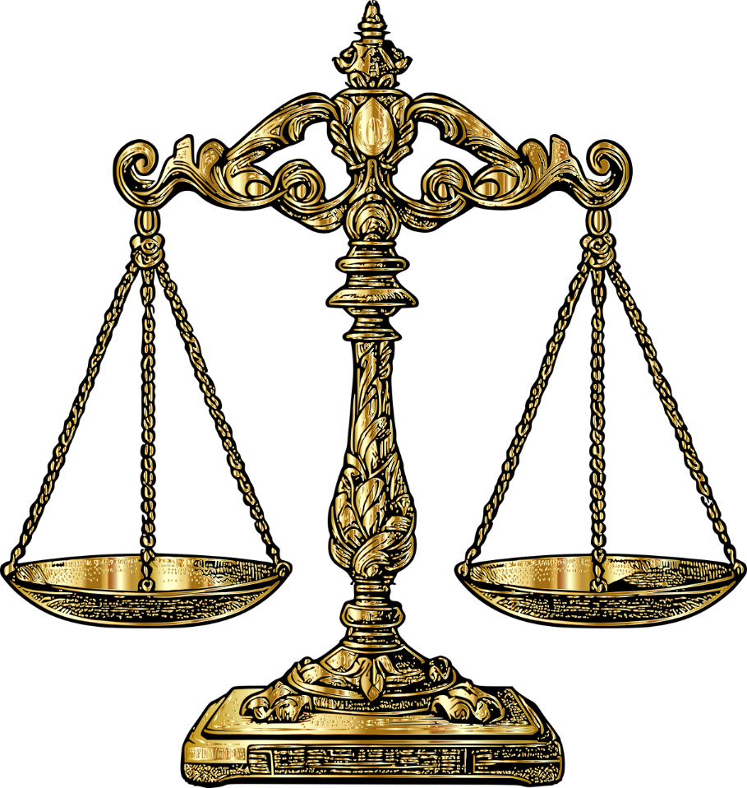
Economic interests of
copyright owners
Strong attitudes/beliefs
about limitations of
copyrights

Slide 5
Why do copyrights include distribution?
To suppress the resale and lending of copies of their work, thereby increasing demand
Allow creator to stop intermediaries who distribute unauthorized copies
To prevent arbitrage, which limits their ability to engage in lucrative, differential pricing (price discrimination)
Arbitrage is the buying and selling in different markets to take advantage of differential pricing.

Slide 6
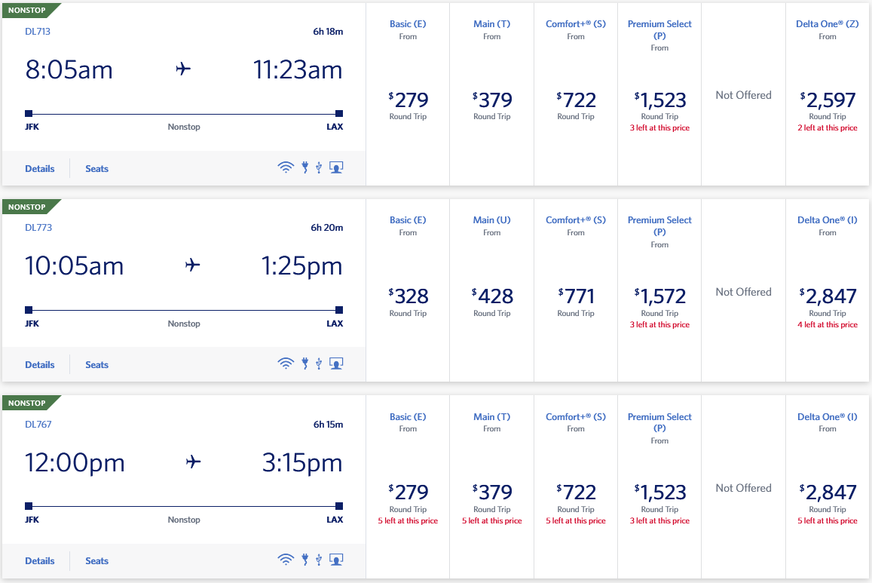
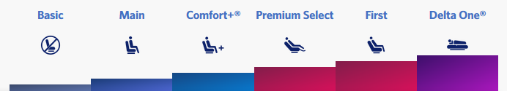
Differential Pricing

Slide 7
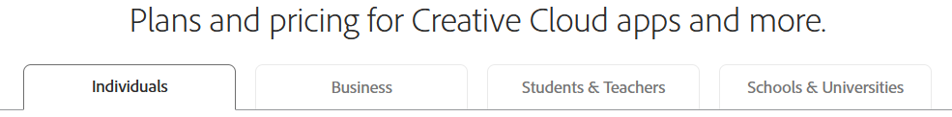
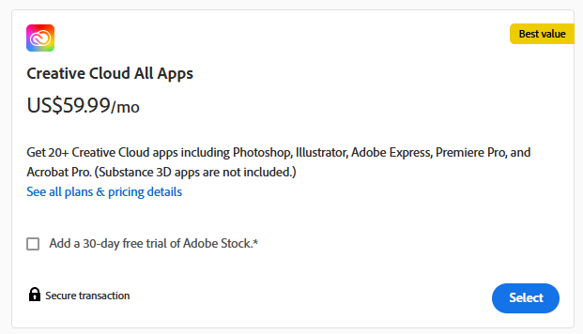
Differential Pricing

Slide 8

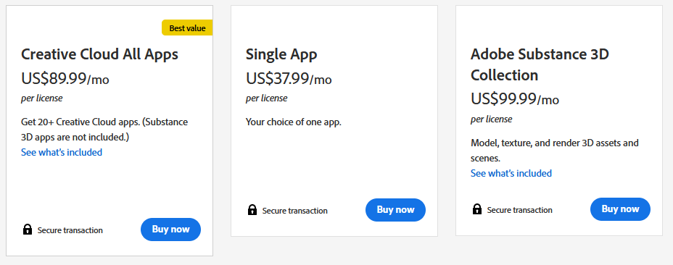
Differential Pricing

Slide 9

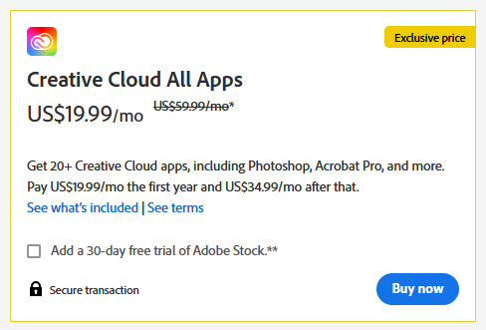
Differential Pricing

Slide 10
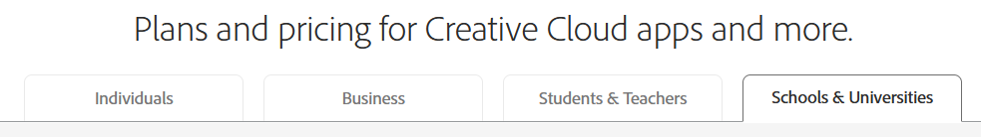
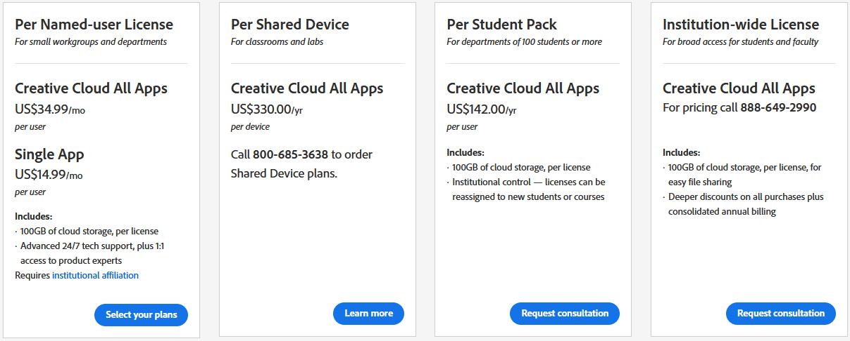
Differential Pricing

Slide 11
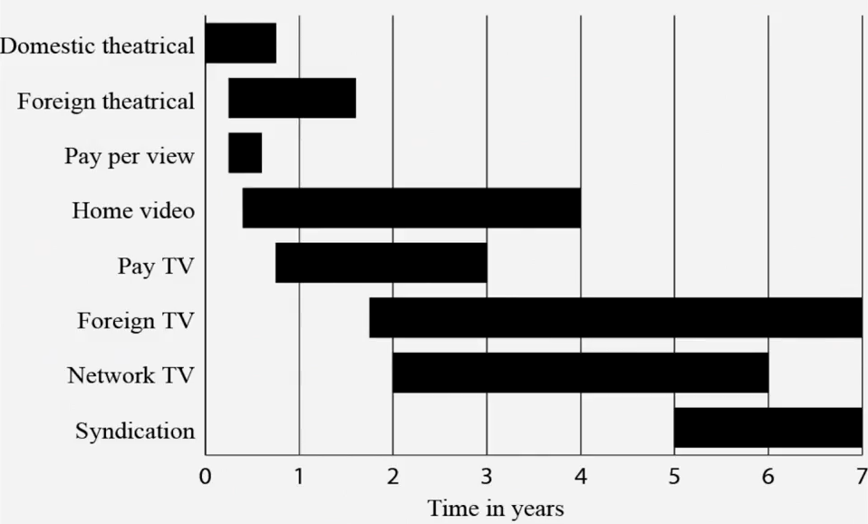
Windowing (Another Form of Differential Pricing)
Motion Pictures

Slide 12
Why are we talking about differential pricing?
Effective price discrimination requires the ability to prevent, or at least limit, arbitrage
  It must be able to stop customers from buying from them at a low price and then reselling them for a higher price
This is where the right to control distribution comes into play

Slide 13
The opposing view
Copyright owners seeking to prevent resales or lending are often seen as greedy
People are skeptical of attempts to control a thing after you’ve sold it
Skepticism over differential pricing

Slide 14
17 USC § 106(3)
Subject to sections 107 through 122, the owner of copyright under this title has the exclusive rights to do and to authorize any of the following:
  (3) to distribute copies or phonorecords of the copyrighted work to the public by sale or other transfer of ownership, or by rental, lease, or lending

Slide 15
First Sale Doctrine
17 USC § 109
(a) Notwithstanding the provisions of section 106(3), the owner of a particular copy or phonorecord lawfully made under this title, or any person authorized by such owner, is entitled, without the authority of the copyright owner, to sell or otherwise dispose of the possession of that copy or phonorecord.

Slide 16
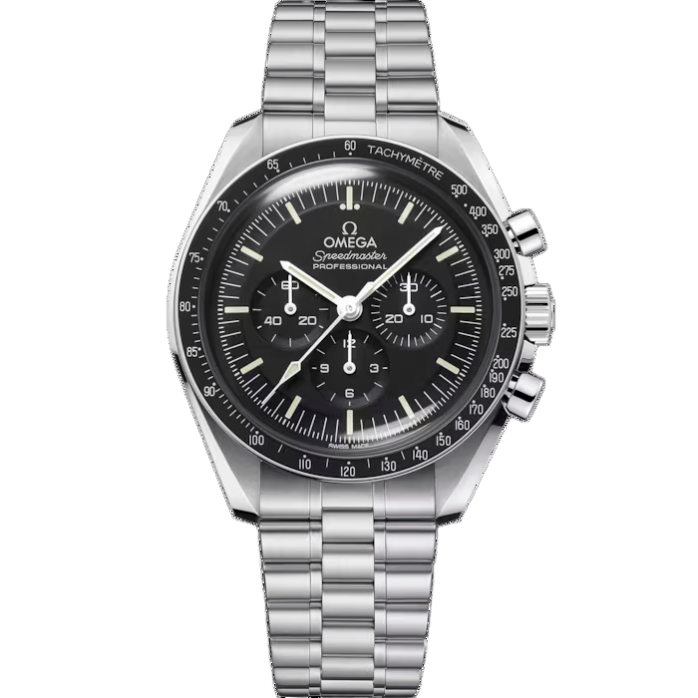

Costco v. Omega
Costco Wholesale Corp. bought a shipment of Swiss-made watches produced by the watchmaker Omega S.A. from another importer (not Omega directly)
Costco purchased these for less than Omega was charging, so they were able to sell them for a lower cost than Omega’s authorized dealer network
Reminder: copyright & useful articles!
Omega contends that Costco’s sales are infringing on their copyright of the Omega logo on the back of the watch case!
$7,000

Slide 17
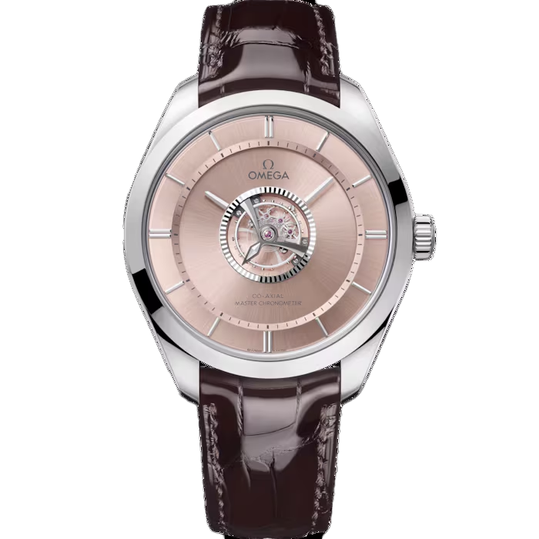
Costco v. Omega
Case Ruling
Trial court favored Costco
Ninth Circuit reversed, ruling that the first sale doctrine did not apply to goods made outside of the U.S.
SCOTUS affirmed (4-4, split decision)
Impact
The Court deadlocked 4-4, which means that the appeals court ruling against Costco stays in place, though the case sets no new high court precedent because it ended in a tie.
Key Legal Issues:
Can Costco resell Omega watches legally purchased from third parties without Omega’s authorization?
Omega claimed that Costco’s importation and resale of its watches violated copyright.
Ninth Circuit Court of Appeals, 541 F.3d 982 (9th Cir. 2008); Case heard by the Supreme Court, split 4-4 (Justice Kagan recused). This means the Court affirms the Ninth Circuit’s decision
$224,800

Slide 18
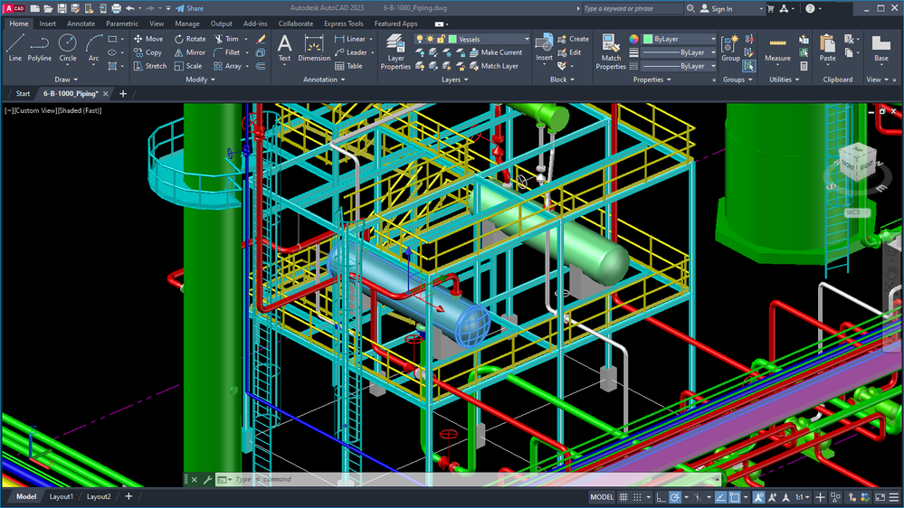
Vernor v. Autodesk

Slide 19
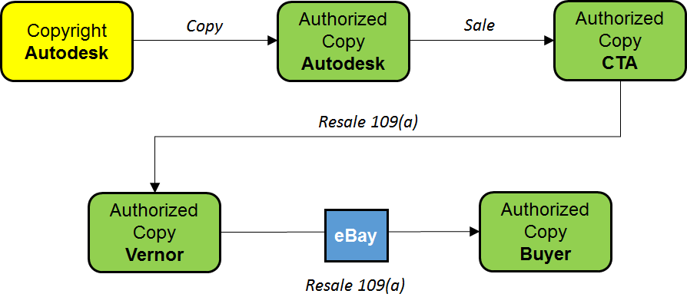
Vernor v. Autodesk
Vernor’s Narrative

Slide 20
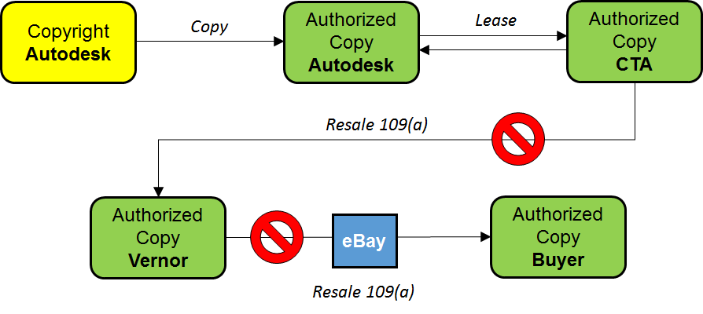
Vernor v. Autodesk
Key Legal Issues
First Sale Doctrine: Can Vernor resell used copies of Autodesk software purchased from a third party?
Licensing: Autodesk claimed its software was licensed, not sold.
Outcome
District court ruled in favor of Vernor, allowing resale under the first-sale doctrine
Ninth Circuit reversed the district court, ruling that Autodesk's software was licensed, not sold, and thus not subject to the first-sale doctrine
Impact
The decision reinforced the distinction between licensed and sold software, limiting the resale rights of software under restrictive licenses
Autodesk’s Narrative

Slide 21
Sale/Transfer: Four Conditions
A copy was lawfully manufactured with the authorization of the copyright owner.
The copy was transferred under the copyright owner’s authority.
The defendant qualifies as the lawful owner of that particular copy.
The defendant thereupon disposed of that particular copy, as opposed to, for example, reproducing it.

Slide 22
Rights: Distribution & Performance
Performances

Slide 23
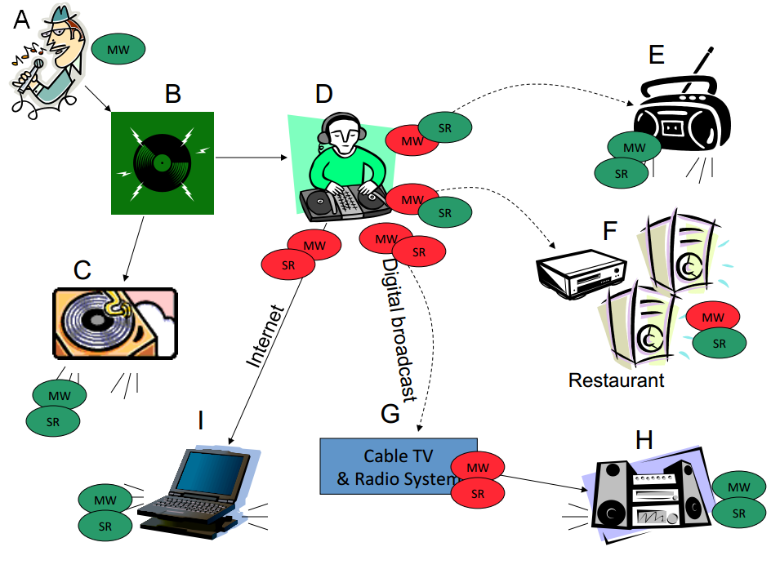
MW: Musical Work; SR: Sound Recording; Private Performance; Public Performance

Slide 24
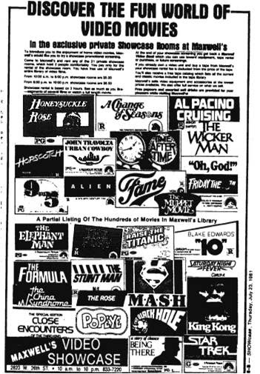
Columbia Pictures v. Redd Horne
Key Legal Issues
Are private showings of video cassettes in viewing booths at Redd Horne’s stores a violation of copyright?
Ruling
District course ruled in favor of Columbia, granting an injunction against Redd Horne.
Third Circuit Court affirmed the district court’s ruling, holding that private showings were unauthorized public performances.
Impact
The decision clarified the definition of public performance under copyright law, emphasizing that even private showings in commercial settings can constitute copyright infringement.
Third Circuit Court (749 F. 2d 154, 1984)
Redd Horne, Inc. operated two video sale and rental stores in Erie, PA called Maxwell’s Video Showcase.
The stores featured small booths that could accommodate 2-4 people. They would select a film from the catalog and watch it in the booth for a fee.
The VHS tapes that were shown in the booth were legally obtained by Maxwell’s.

Slide 25
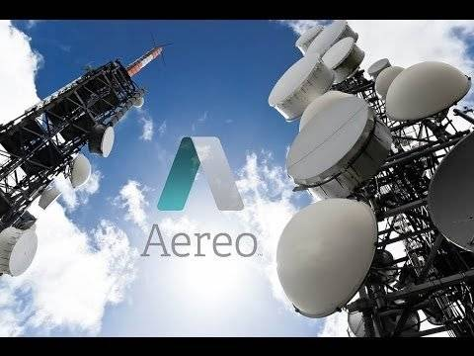
American Broadcasting (ABC) v. Aereo
SCOTUS, 573 U.S. 431 (2014)
Aereo, Inc. provided a unique service that allowed its subscribers to watch live and time-shifted streams of over-the-air television broadcasts on internet-connected devices.
Aereo would assign a user their own antenna so that a user could watch a program broadcast online.

Slide 26
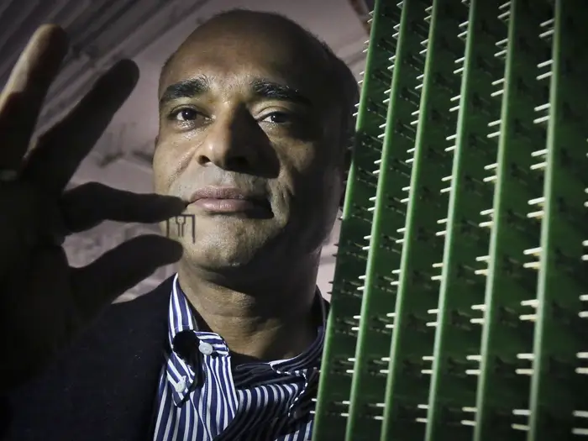
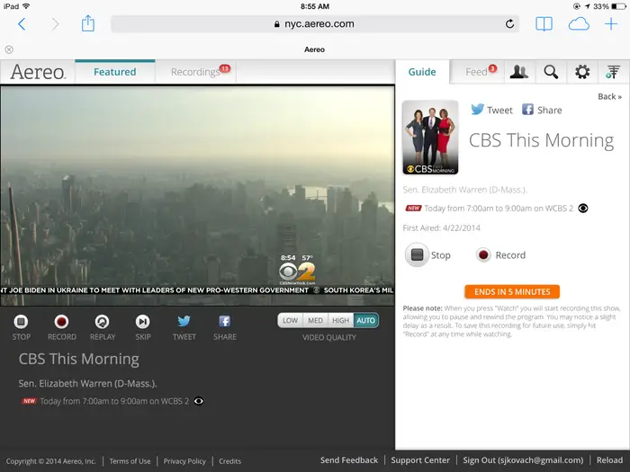
American Broadcasting (ABC) v. Aereo
Key Legal Issues
Does Aereo’s service constitute a public performance?
Ruling
District court denied preliminary injunction against Aereo
Second Circuit Court affirmed district court’s ruling
SCOTUS reversed, ruling that Aereo’s service was a public performance and required permission from copyright holders
Impact
The decision reinforced broadcasters' control over the retransmission of their content and clarified the application of the public performance right in the digital age

Slide 27
Rights: Distribution & Performance
Exceptions and Limitations

Slide 28
Exceptions to Public Performance Right
Classroom
Distance Learning
Religion
Non-profit
“Homestyle”
Fairness in Music Licensing Act (FMLA)
Some Webcasts
Real-Space Displays

Slide 29
Compulsory Licenses
Public Broadcasting System
Some Webcasts
Cable Retransmissions
Satellite Retransmissions
Jukeboxes

